Slide 1
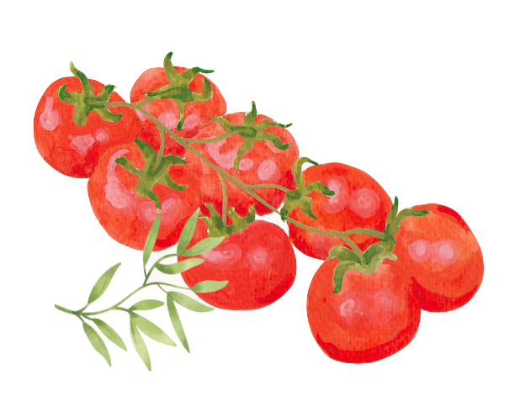


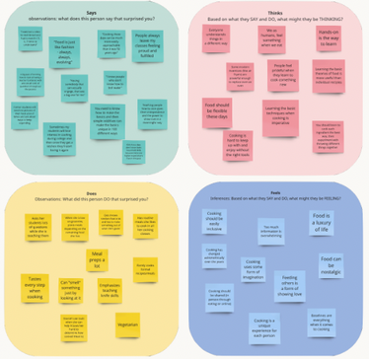
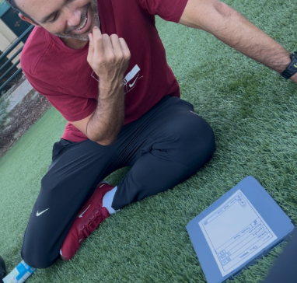
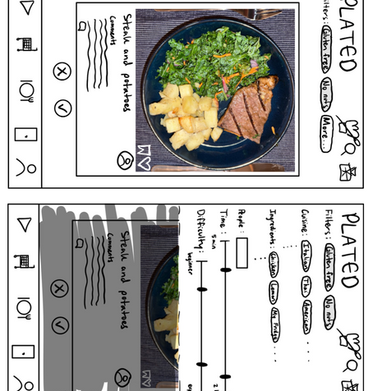
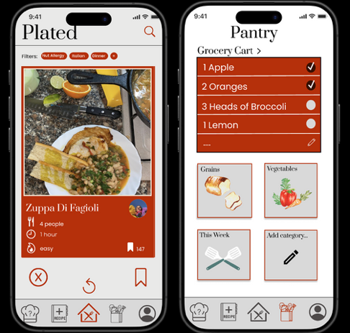
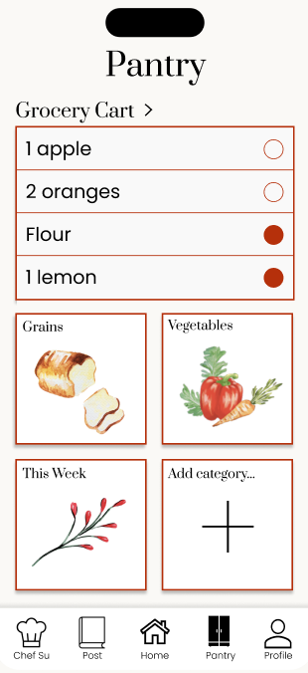
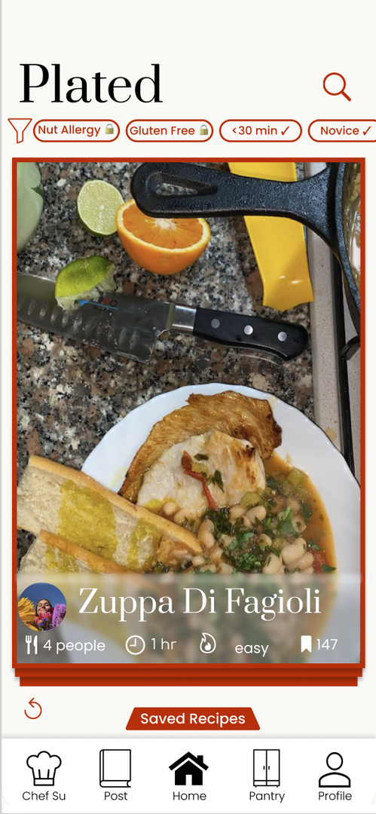
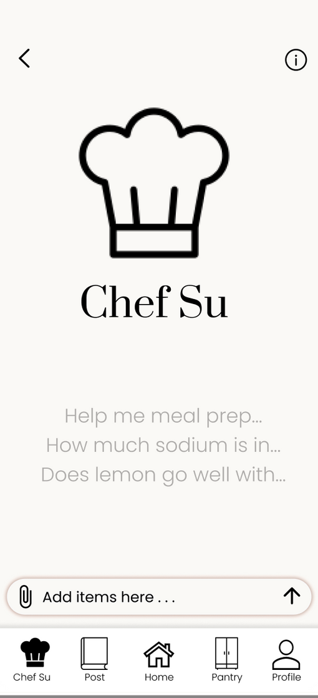



Design Process
Needfinding
Experience Prototype
Low-Fi Prototype
Med-Fi Prototype
Problem
Amateur chefs see cooking as a chore that takes too long and has no room for creativity.
Solution
Plated provides personalized recipes and an in-app chef assistant to make cooking easy, enjoyable, and collaborative.
Add to your pantry
Swipe through recipes
Ask cooking questions
Designed and developed by Maya A., Emma M., Graham G., and Ashley V.
CS 147 Autumn 2024
https://hci.stanford.edu/courses/cs147/2024/au/projects/Design-for-Healthy-Behaviors/Plated/

